Slide 1
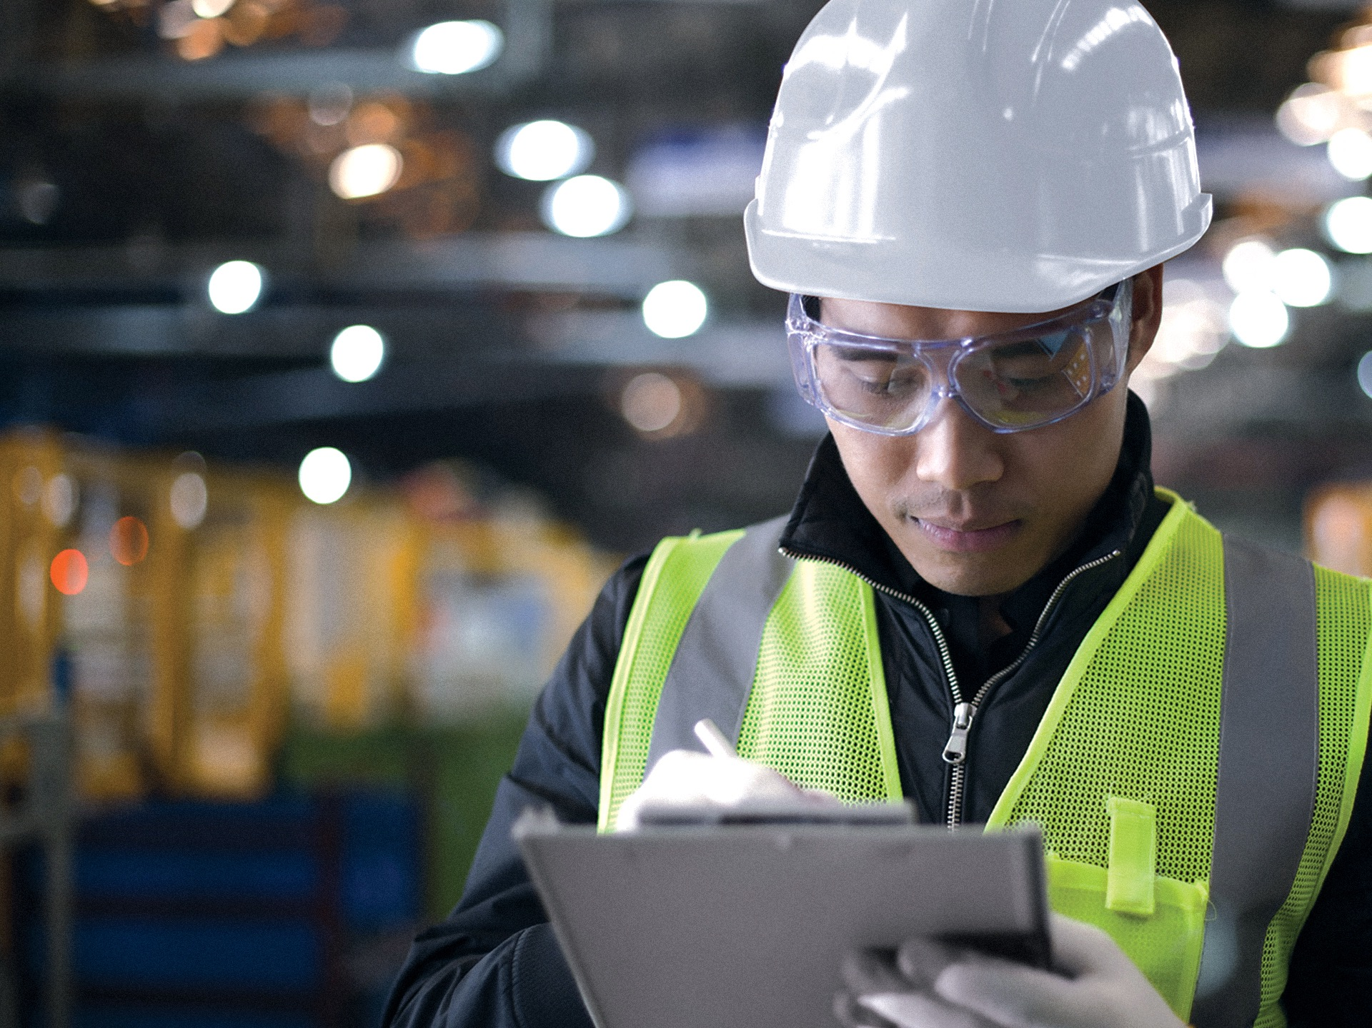
Office Based Manual Material Handling
& Back Injury Prevention

Slide 2
Facts & Stats
Manual Material Handling (MMH) involves the moving of materials by hand through lifting, lowering, carrying, pushing, pulling, shoveling or any combination of these actions.
Our history of injures related to lifting and body motion shows that our colleagues suffered injuries which varied in severity from a minor first aid incident to more serious injuries where medical treatment was required.
If we examine all the above injuries, we realize that a majority of our colleagues are injured while performing MMH tasks.

Slide 3
Examples of incidents
    An employee injured his back when he attempted to move a heavy box.
    An employee felt pain in her shoulder as she moved a chair to clean a conference table.
    Worker was shoveling ballast when he felt a pain in the lower back. Worker was taken to medical aid and diagnosed with a muscle spasm.
    Worker was sliding their office desk closer to the wall and injuired his back.
    Worker bent down to pick up his equipment when he experienced a pinching pain in the lower to mid lumbar region of the back.
    Worker sustained strain to right hip and lower back while lifting a panel during office clean up.

Slide 4
MMH Injury Factors
Amount of Force
Anytime you bend or lean over to pick something up, you put tremendous pressure on your lower back.
Being Overweight
  Excessive weight increases physical stress on the body.
Poor Posture
Results from certain muscles tightening up or shortening while others lengthen and become weak.
Pre-Existing Back Injury
  Previously injured backs can pre-dispose you to back problems and are more easily re-injured.
Repetitive Movements
  Caused by repetitive tasks, forceful exertions, vibrations, mechanical compression, or sustained and awkward positions.
Age
  Wear and tear on joint.

Slide 5
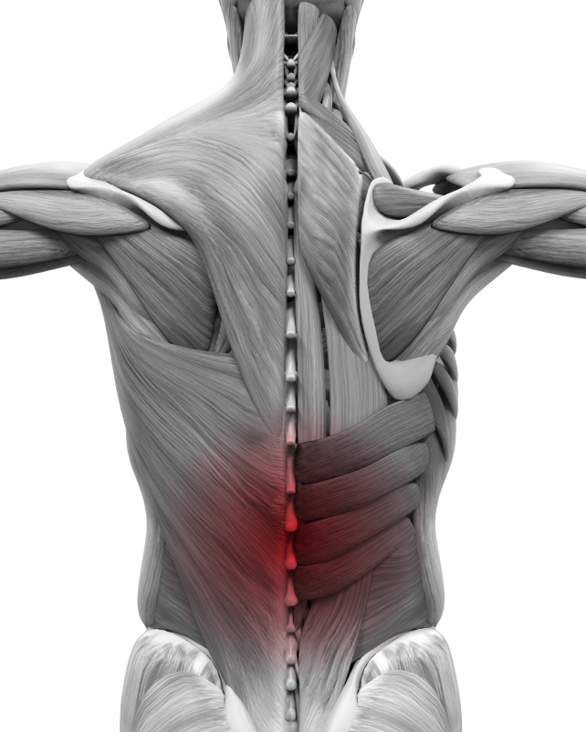
MMH Hazard Factors
Manual Material Handling (MMH) can be potentially hazardous when:
    Lifting or lowering is done too quickly
    The activity is done over an extended period of time
    Working in awkward positions
    Maintaining long term static positions
    Working without a warm up
When one or more of the
Injury Factors is paired with
one or more Hazard Factor,
the likelihood of a Serious Injury
happening is dramatically increased.

Slide 6

Stretch & Flex
    Stretching before conducting a lift Program
    Done prior to lifting
    Only takes minutes
    Requires everyone’s participation before lifting

Slide 7

Health Benefits
    Decreases the risk of injury
    Warms and prepares muscles
    Increases the range of motion
    Improves flexibility and circulation
    Helps to decrease strains and sprains
    Stress relief
v
Remember to
warm up first

Slide 8

The Principles of Stretching
    Only stretch to your individual comfort level
    You should feel tension not pain
    Hold each stretch for 15-30 seconds, 2 reps of each
    Breathe normally throughout each stretch
    Never bounce the stretch
    Perform each stretch in a slow and controlled manner
    Maintain proper posture
    Take a few seconds to go in and out of each stretch
    Stretch both sides equally
    If you feel the need during your shift, run through stretches again
WARNING
If you have any health issues or feel any discomfort while doing any of these stretches, stop immediately and check with your healthcare provider before continuing.

Slide 9
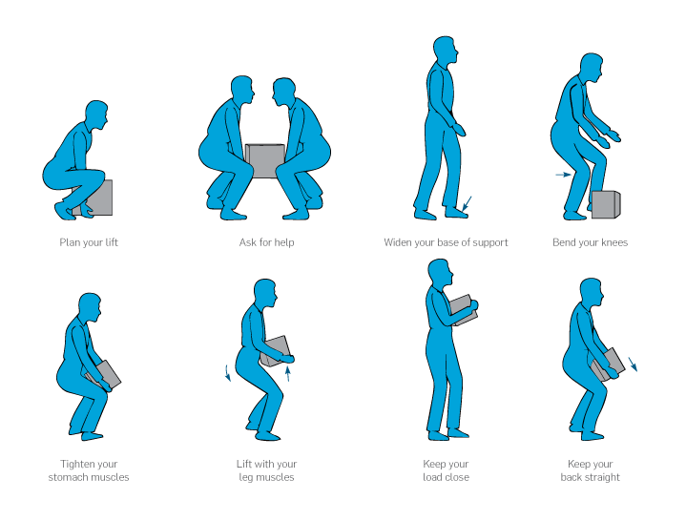
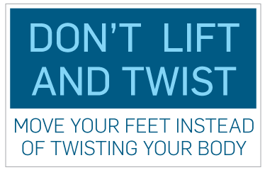
The Do’s and Don’ts of Lifting
Do’s
      Try to keep your center of gravity as low as possible
      Keep your back straight
      Bend at the knees and hips
      Maintain good foot position
      Use Material Handling Equipment whenever possible to avoid manually lifting heavy objects
Don’ts
      Move furniture – call facilities management
      Lift bulky or heavy loads alone
      Twist while lifting
      Use your back
      Lift more than you can easily handle
      Lift from an unbalanced position. This means no lifting from one knee or while reaching over another object.
      Carry a load that blocks your view ahead

Slide 10
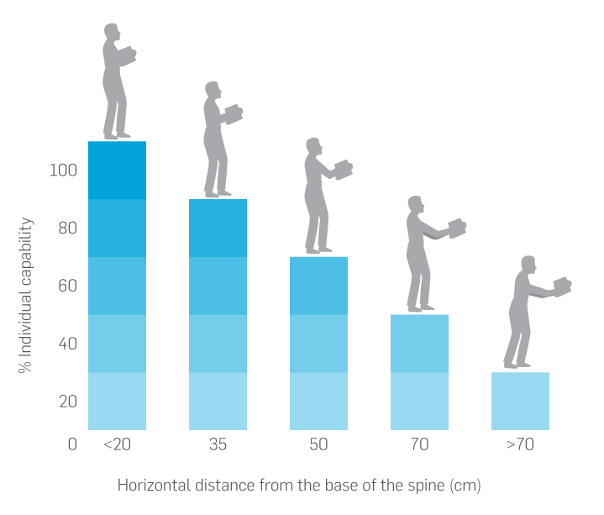
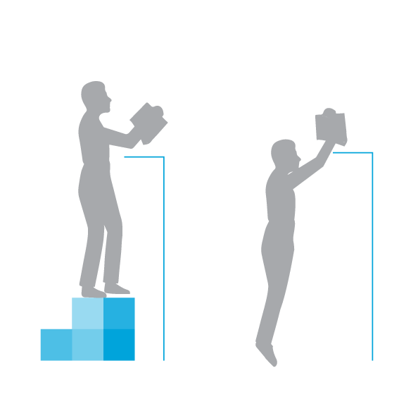
Safe Work Practices: Reaching
Is the load height located inside your
“safe lifting zone”?
      Located between the knees and shoulders
      Bend your knees and lift with your legs
      If above shoulders, use a stool or ladder
      If its heavy, get help
Reaching Overhead
FACT: When a load is held away from the body, the stress on the lower back increases substantially and the maximum weight you can lift safely is reduced (Figure 2). Long reaches increase the risk of a lower back injury.
      Wide base of support
      Safe platform or step stool
NOT

Slide 11
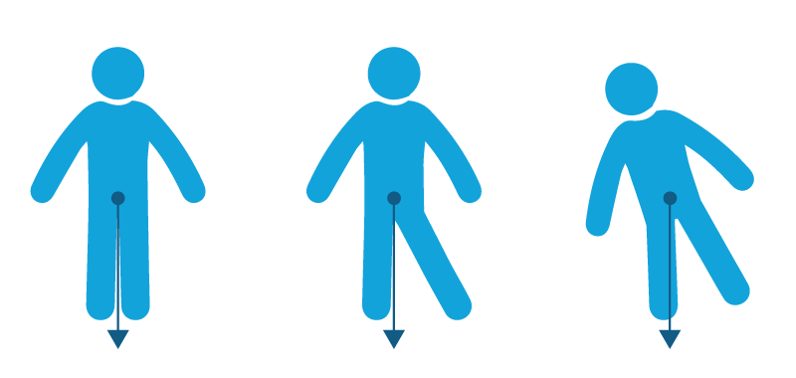
Safe Work Practices: Center of Gravity
When working, maintain a stable center of gravity. Be aware of your surroundings and plan your lift.
Ask yourself these questions:
Can handling aids be used?
Where is the load going to be placed?
Will help be needed with the load?
Are there obstructions that need to be removed?
Are there any changing conditions?
a
b
c
Center of gravity
Center of gravity
Center of gravity

Slide 12
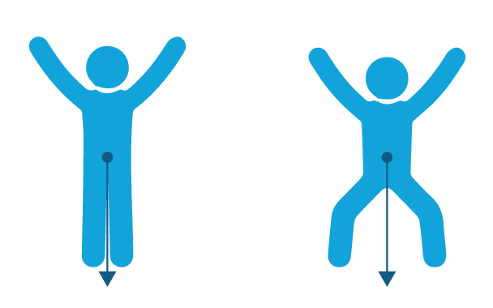
Safe Work Practices: Base of Support
Maintain a comfortable base of support. A wider stance is recommended;
this will provide you with maximum stability while lifting.
Keep your feet apart
Place one foot slightly ahead of the other
Flex your knees to absorb jolts
Turn with your feet during a lift, not at the waist, to maintain your stability
Avoid tight clothing or unsuitable footwear that may make the lift difficult.
Stable
More stable

Slide 13
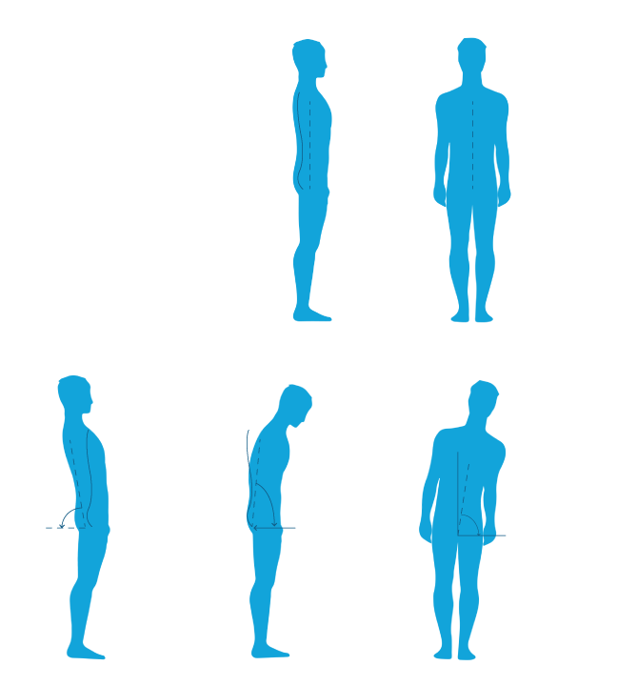
Safe Work Practices: Body Alignment
Maintain proper Body Alignment while working:
Try to keep body in neutral position
Avoid awkward positions
Take micro-breaks and the time to stretch
throughout the day
Avoid long term static posture
Avoid undue stress on joints
Neutral
Posture
Awkward
Posture
Back extension
Back Flexion
Lateral Bending

Slide 14
Safe Work Practices: Static Postures
Risk Factors
Contributing Factors
Static posture refers to physical exertion in which the same position is held throughout the task. This type of exertion puts increased force on the muscles which contributes to fatigue and MMH injuries.
Holding arms up
Poor workstation layout:
The location of equipment, machinery, and materials in relation to how the job is performed
Fixed workstation
Bending over
Floor level work
Poor workstation set-up
No seating available
Recommended Limits
Squatting
Equipment is hard to reach
No seating available
Low Risk
LIMIT
Hr. Rotations
If a static posture must be maintained for extended periods of time, micro-breaks and stretching every 2hrs is highly recommended.
2
Standing Continuously
Performing the same task over and over
No seating available
Sitting Continuously
Performing the same task over and over
Workstation is not adjustable

Slide 15
Conclusion
As you have seen, many factors play a role when it comes to Manual Material Handling and how it effects the body but by being aware of your movements, warming up & stretching before a shift and properly planning your tasks, you’re taking the right step in injury prevention.
    Quick Recap
    Request Office services support for any move of office furniture or heavy objects
    If lifting - Lift, hold, and carry materials close to your body.
    Plan ahead to save time and effort.
    Use carts or dollys to transport heavy materials when possible.
    Avoid static or awkward postures and positions.
    And Remember to Warm-Up / Stretch as needed.

